Slide 1


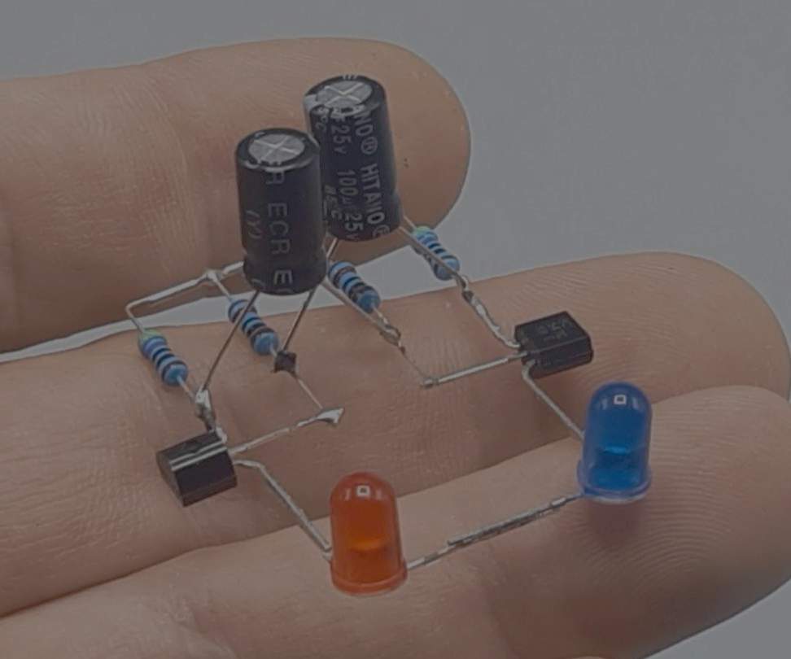


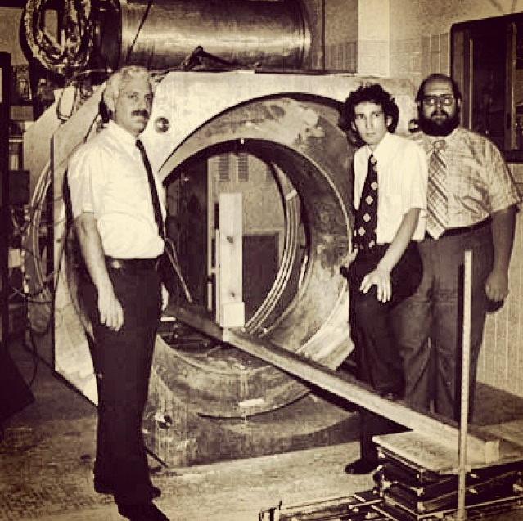


BEYOND LEVEL
0
PITCH DECK
VIT Bhopal Student chapter

Slide 2



TITLE HERE

Slide 3
TEAM NAME

Slide 4
Problem statement
Define the exact Problem that you intend to solve.
[Not more than 250 words]

Slide 5
SOLUTION
Explain,in brief how you intend to solve the problem

Slide 6
POTENTIAL IMPACT OF SOLUTION
Why your solution is relevant for that specific problem?
How will your solution solve the problem?
What your solution do?
How easily can your solution be implemented and how effective it will be?

Slide 7
TARGET AUDIENCE

Slide 8
MARKET ANALYSIS

Slide 9
THE TECHNICAL APPROACH AND TOOLS

Slide 10
FUTURE PLANS

Slide 11
THANK YOU

Slide 12
TEAM MEMBERS
REGISTRATION NO.

Slide 13
Kindly ensure to keep the presentation within 7-10 slides. Don't exceed this limit

